Slide 1
Overview
  Acceptance Test Scenario
  TestNG
  Selenium Grid
  SeleniumGridPlugin
  Workflow design, execution
  Test implementation
  Conclusion
1

Slide 2
Acceptance Test Scenario
Goal/Tools
The gole of this scenario is
  to have high level user acceptance tests for verifying a web application from the user point of view
  to check the browser compatibility of the application
  a distributed way of running the tests
  to validate the interaction between Workflow Designer and tests execution
Tools applied for these scenario
  TestNG – „JUnit” like test framework having more advanced features with capabilities of running funtional/user acceptance tests
  Selenium – web testing tool

Slide 3
Web application under test
ETICS Test System
Test Tool Registartion system is a GWT based web application
  GWT based web application (client/server side)
  is the entry point to perform plugins management
  is a tab on the ETICS web portal
As architecture:
  GWT based web application (client/server side)
  Server side: - webservices
    for the plugin registartion
    for the plugin template generation

Slide 4
TestNG – testing framework
Overview
  Based on Annotation Support
  Data driven tests (@DataProvider)
  Dependency tests
  Test groups
  Tests suites through xml files
  Passing of parameters using xml or @DataProvider
  Rerunning of the failed tests using testng-failed.xml
  Running tests in paralel
  Close colaboration with selenium

Slide 5
Selenium – set of web testing tools
Overview
  Homepage: http://seleniumhq.org/
  Components
  Selenium-IDE – Firefox Add-on
  Selenium commands –selenese – Test scripts
  Selenium-RC
  Selenium Grid

Slide 6
Selenium- IDE
Overview
  capable of recording user interaction by keeping account of user actions as they are performed and store them as a reusable script to play back
  It has a context menu integrated with the Firefox browser, which allows the user to pick from a list of assertions and verifications for the selected location.
  The tests default format is .html but can be exported on different formats such as: Java Junit, Java TestNG, Python, Ruby.
  Later on, the exported tests can be run in a continuous integration environment

Slide 7
Selenium commands - Tests
Overview
Examples of tests are
  UI element is present somewhere on the page
  specific text is somewhere on the page
  specific text is at a specific location on the page
  Test consists of Selenium commands, called selenese, that performs different operations such as
    Open a page
    click on a specific element
    Assertion, verification of different UI elements
A sequence of these commands is a test script.

Slide 8
Selenium – Remote Control
Overview
Selenium component composed of a
  Selenium Server
    launches and kills browsers
    interprets and runs the Selenese commands passed from the test program, and acts as an HTTP proxy, intercepting and verifying HTTP messages passed between the browser and the Application Under Test
  Client libraries which provide the interface between each programming language and the Selenium-RC Server.

Slide 9
Selenium Grid
Overview
  Consists of
  a Selenium HUB
  and several RCs (Remote Controls)
HUB is in charge of
  Allocating a Selenium Remote Control to a specific test (transparently)
  Limiting the number of concurrent test runs on each Remote Control
  Shielding the tests from the actual grid infrastructure

Slide 10
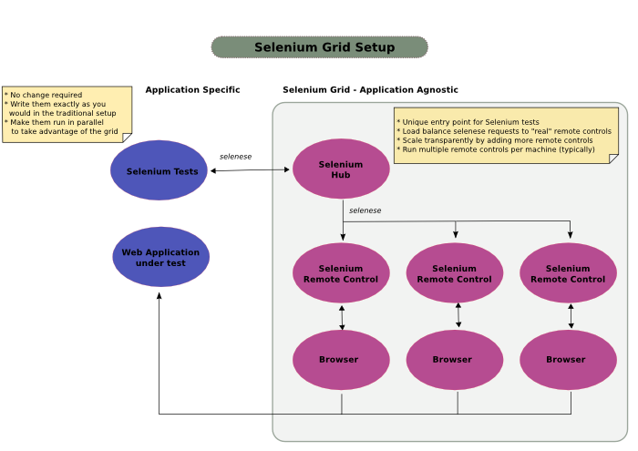
Selenium Grid
Architecture

Slide 11
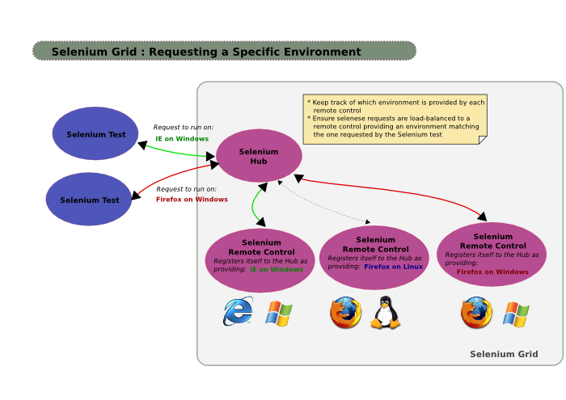
Selenium Grid
Architecture

Slide 12
Acceptance Test Scenario
To sum up the scenario
  As infrastructure Selenium Grid consists of a HUB (acts as a server) that controls the tests running on different Selenium RC remote controls (acting as clients).
  In other words RCs registers themselves into the HUB while the HUB distributes the tests to different RCs.
  RCs runs the tests in the associated browsers
  The tests are recorded using Selenium IDE (Firefox Add-on) and exported in TestNG format and rewritten according to needs.
  Most of these functionalities are implemented in the SeleniumGridPlugin.

Slide 13
SeleniumGridPlugin
Functionality
The core functionality is incorporated in the plugin as an ant script
  Setting up the infrastructure
    Verifying the availability of a grahical interface necessary for running the browsers (xvfb (X Windows Virtual Frame Buffer) )
    Starting the hub
    Starting the RCs
  Running the TestNG tests
    Compiles and runs TestNG tests
    Stops all the selenium processes
  Cleaning the environment
    Stop the HUB

Slide 14
Configurations
To set up the test process
  For the HUB processes
    Starting the HUB
    Building and Running the tests
    Stop the HUB, cleaning the environment
  For the RC processes
    Starting several number of RC processes for different types of browsers (For example: 5 firefox, 3 opera )

Slide 15
Operation steps
Secvential vs Workflow approach
  ETICS hub configuration should be run. The HUB is started and waiting for RCs to be registered. HUB needs the URL of the application under test
  ETICS RCs configuration is run. The RCs are registered in HUB, for this operation they need the URL console of the HUB. Additionally the RCs need their own host name.
  When the RCs environments are ready the HUB should receive an output return value from the RCs specifying that the HUB could start running the tests.
  ETICS hub configuration (build optional or test) should run the tests.
  Hub should return an output return value that the tests are ready.
  ETICS hub configuration should run –t clean option to terminate all the selenium processes.

Slide 16
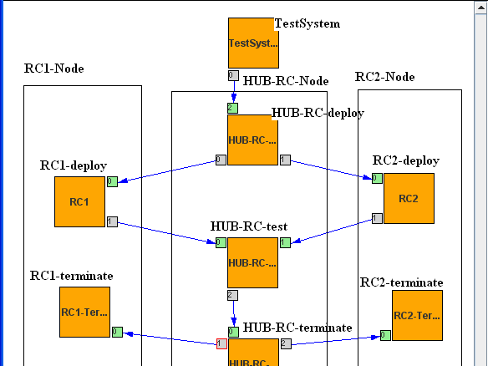

Slide 17
Workflow execution
TO BE DISCUSSED !!!

Slide 18
Implemented tests
Example
Creation of multiple versions for a specific component – the information necessary for new versions creation is passed using the DataDriven feature of the TestNG.
For example:
@DataProvider(name = "DP1")
public Object[][] createData() {
Object[][] retObjArr={{"test01Plugin"},
{"test02Plugin"},
{"test03Plugin"}};
return(retObjArr);
}
@Test(dataProvider = "DP1")
public void testTSSteps(String pluginName) throws Exception {

Slide 19
Difficulties encountered
  Not to much documentation is available
  No books, no e-books
  The generated tests not run in a continuous integration environment they should be rewritten, they serve just as a „template”
  No reports are available, just the standard JUnit or TestNG report
  Availability of graphical interface on linux environment necessary for the launching of browsers

Slide 20
Benefits of this scenario
  Browser tests are slow even the simple ones, Grid approach - running tests in a distributed way reduces the time
  Browser compatibility, different versions can be tested in an advanced way
  Reveals the power of the „workflow” approach comparing to sequential running of different configurations

